Slide 1

(Serverless Technologies) ( Msc DevOps - Research Project)
Knative VS Azure Function
- Ainul Habib

Slide 2



Objectives
Simple view of the Serverless technologies
Compare the Serverless technologies offering by
Azure Function ( offered by Microsoft Azure )
Knative ( CNCF Opensource )
Features to Compare
Technology Distinctions
Deployment and Management Overheads
Cold Start and Performance Metrics
Cost Analysis

Slide 3
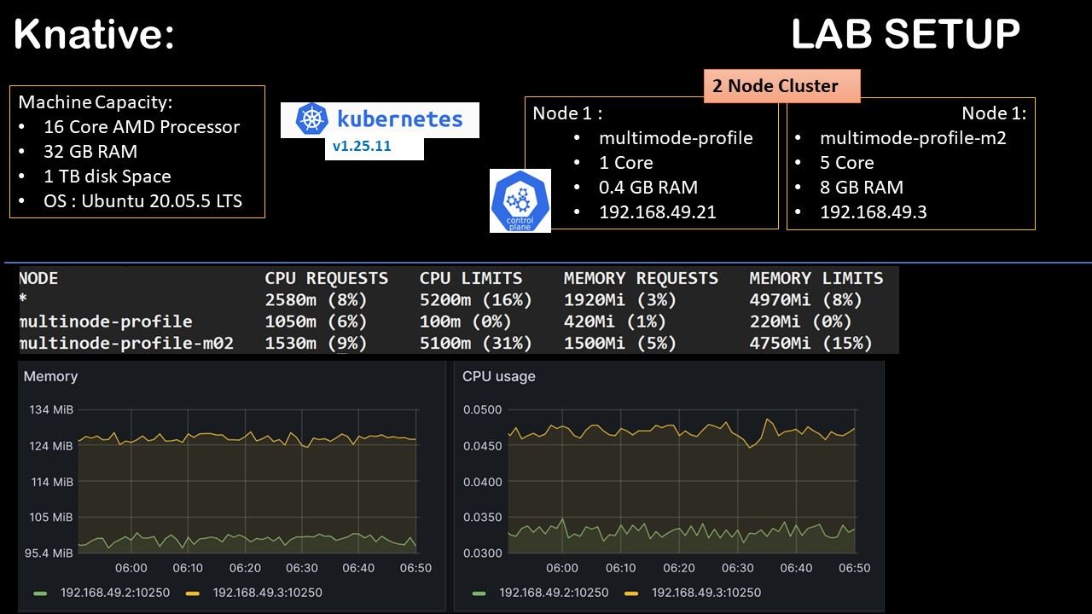
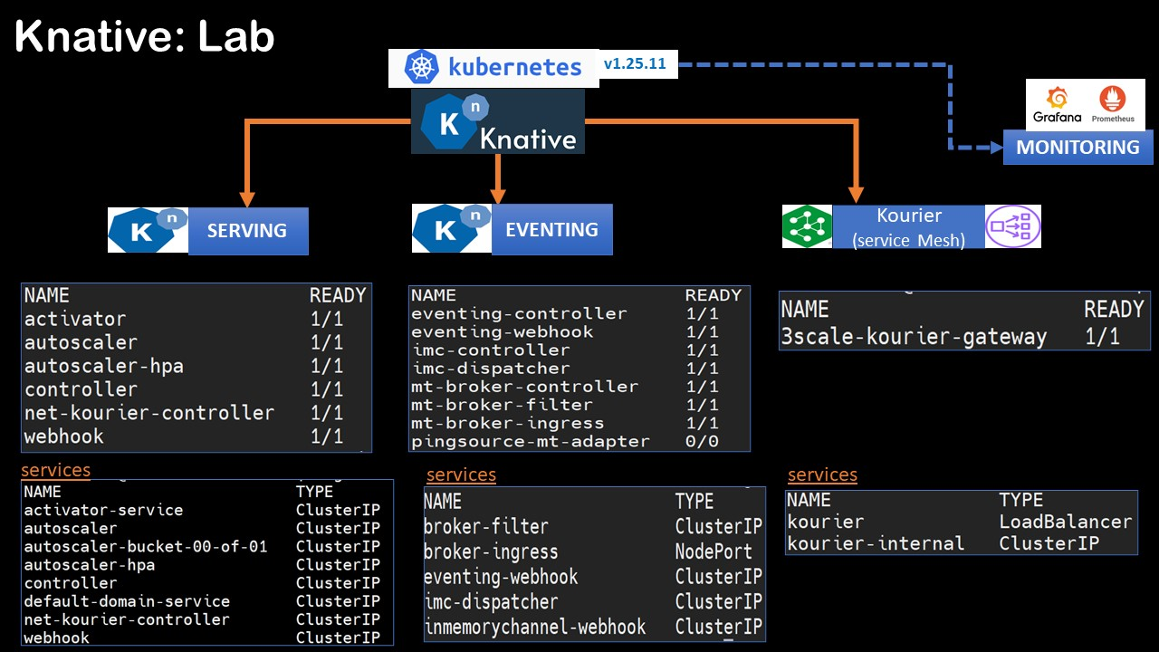
Research Lab Setup

Slide 4
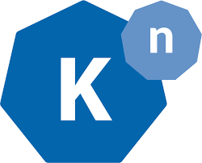






Technology Distinction
15 PODS (min)
15 Services (min)
Offered
pod
SERVING
pod
Offered as CRD(s) and Services
Kourier
(service Mesh)
Serving Orchestrates the POD(s)
pod
Each Pod Container has Application Runtime, with Sidecars for Serving
EVENTING
pod
Application Code + Runtime Container
envoy
Queue
No extra components need to be preinstalled
Functions
Under Application
Function Application run in a containers
Various Plans are Available for Functional resources allocation.
Azure Functional App
Example : the default Consumption Plan offers
- 1 CPU and 1.5 GB, 5 GB

Slide 5
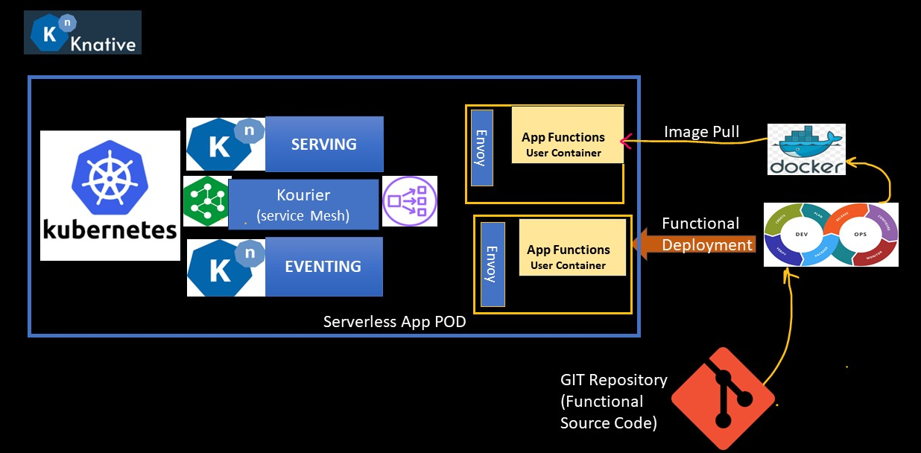
Deployment Overheads

Slide 6
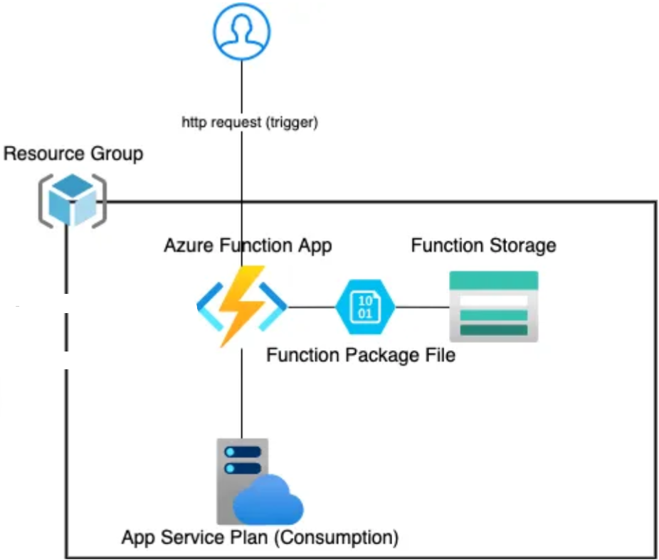

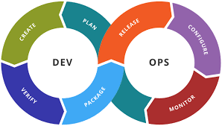
Deployment Overheads
GIT Repository
(Functional Source Code)
DevOps Pipeline

Slide 7
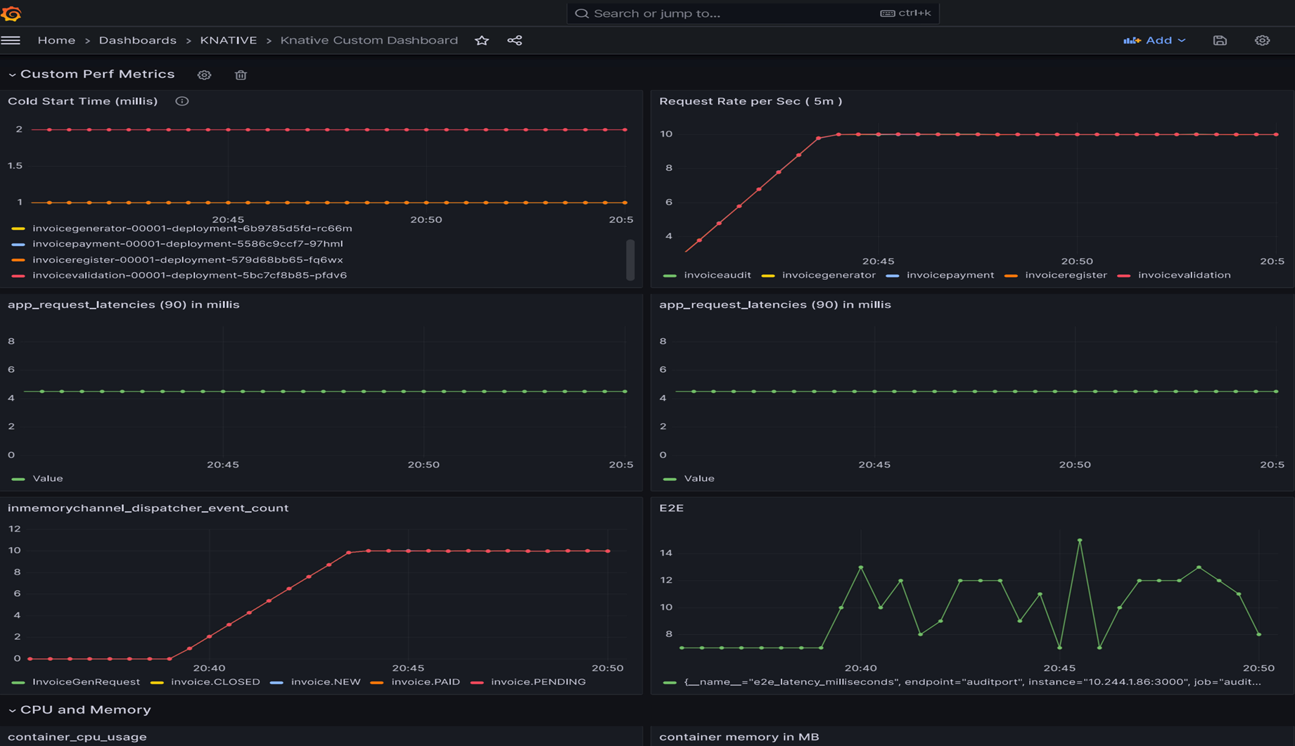
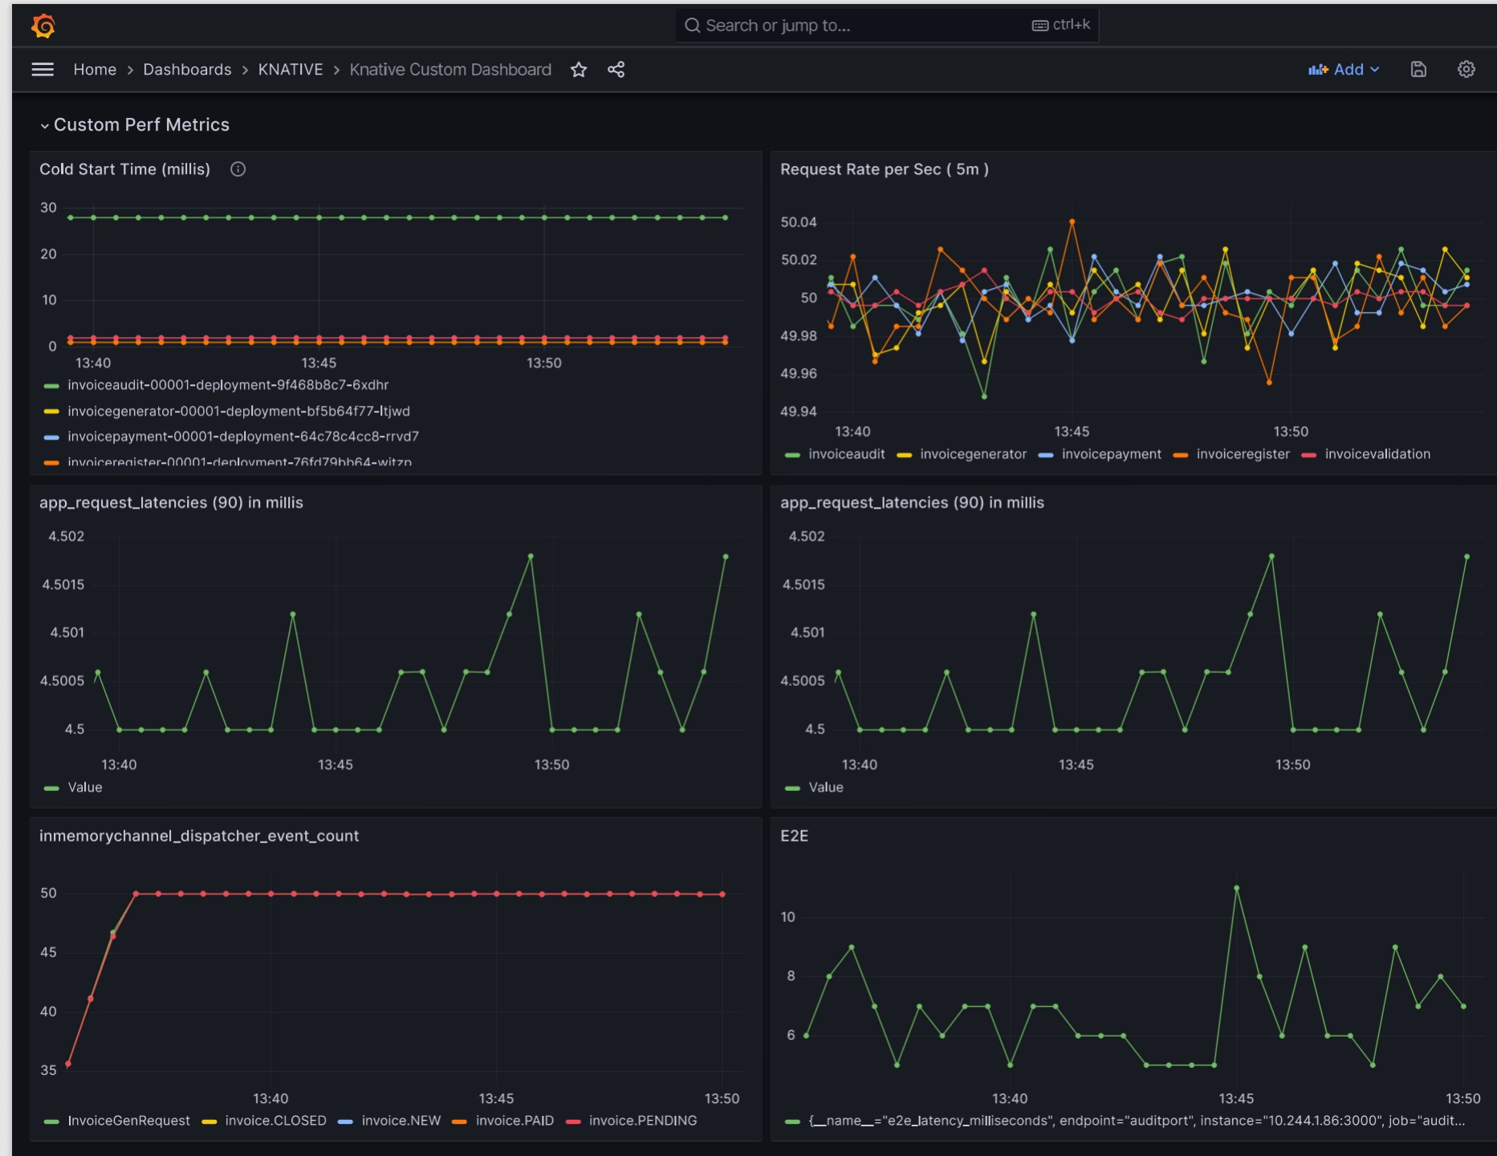
Cold Start and Performance

Slide 8

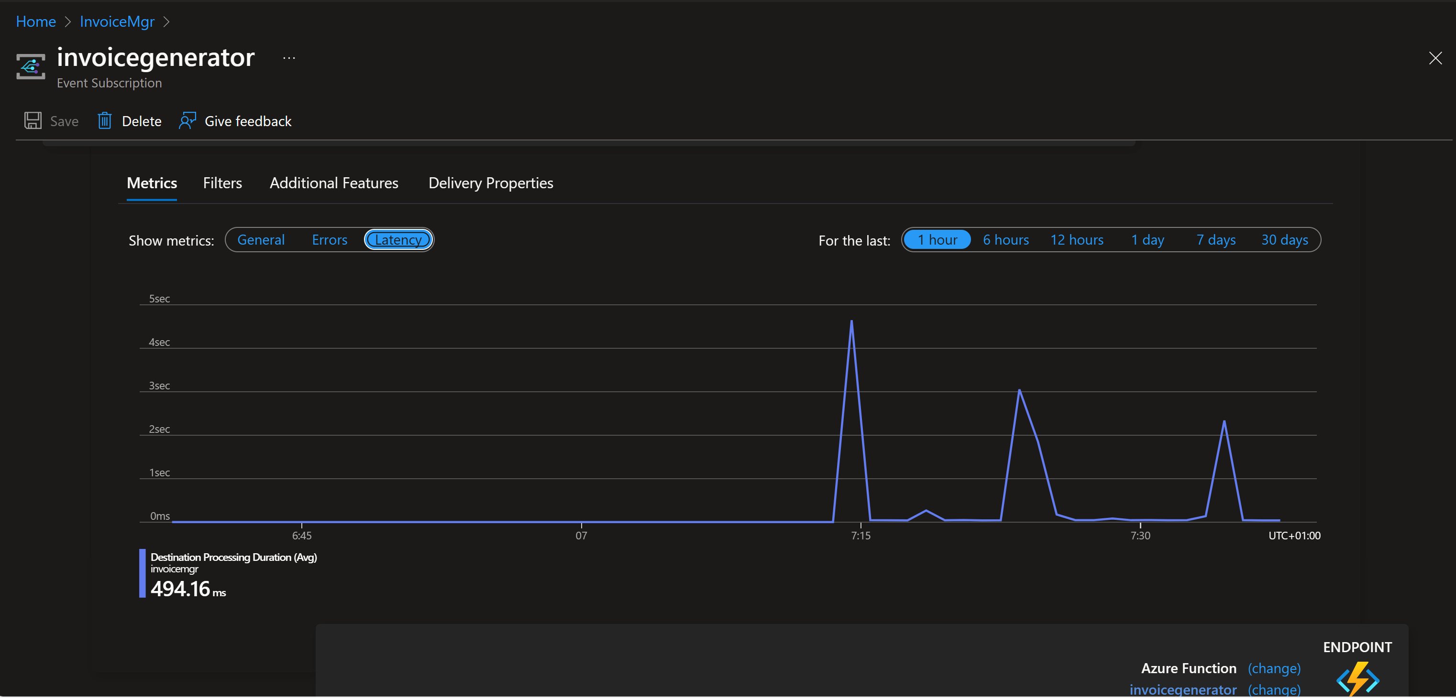


Slide 9
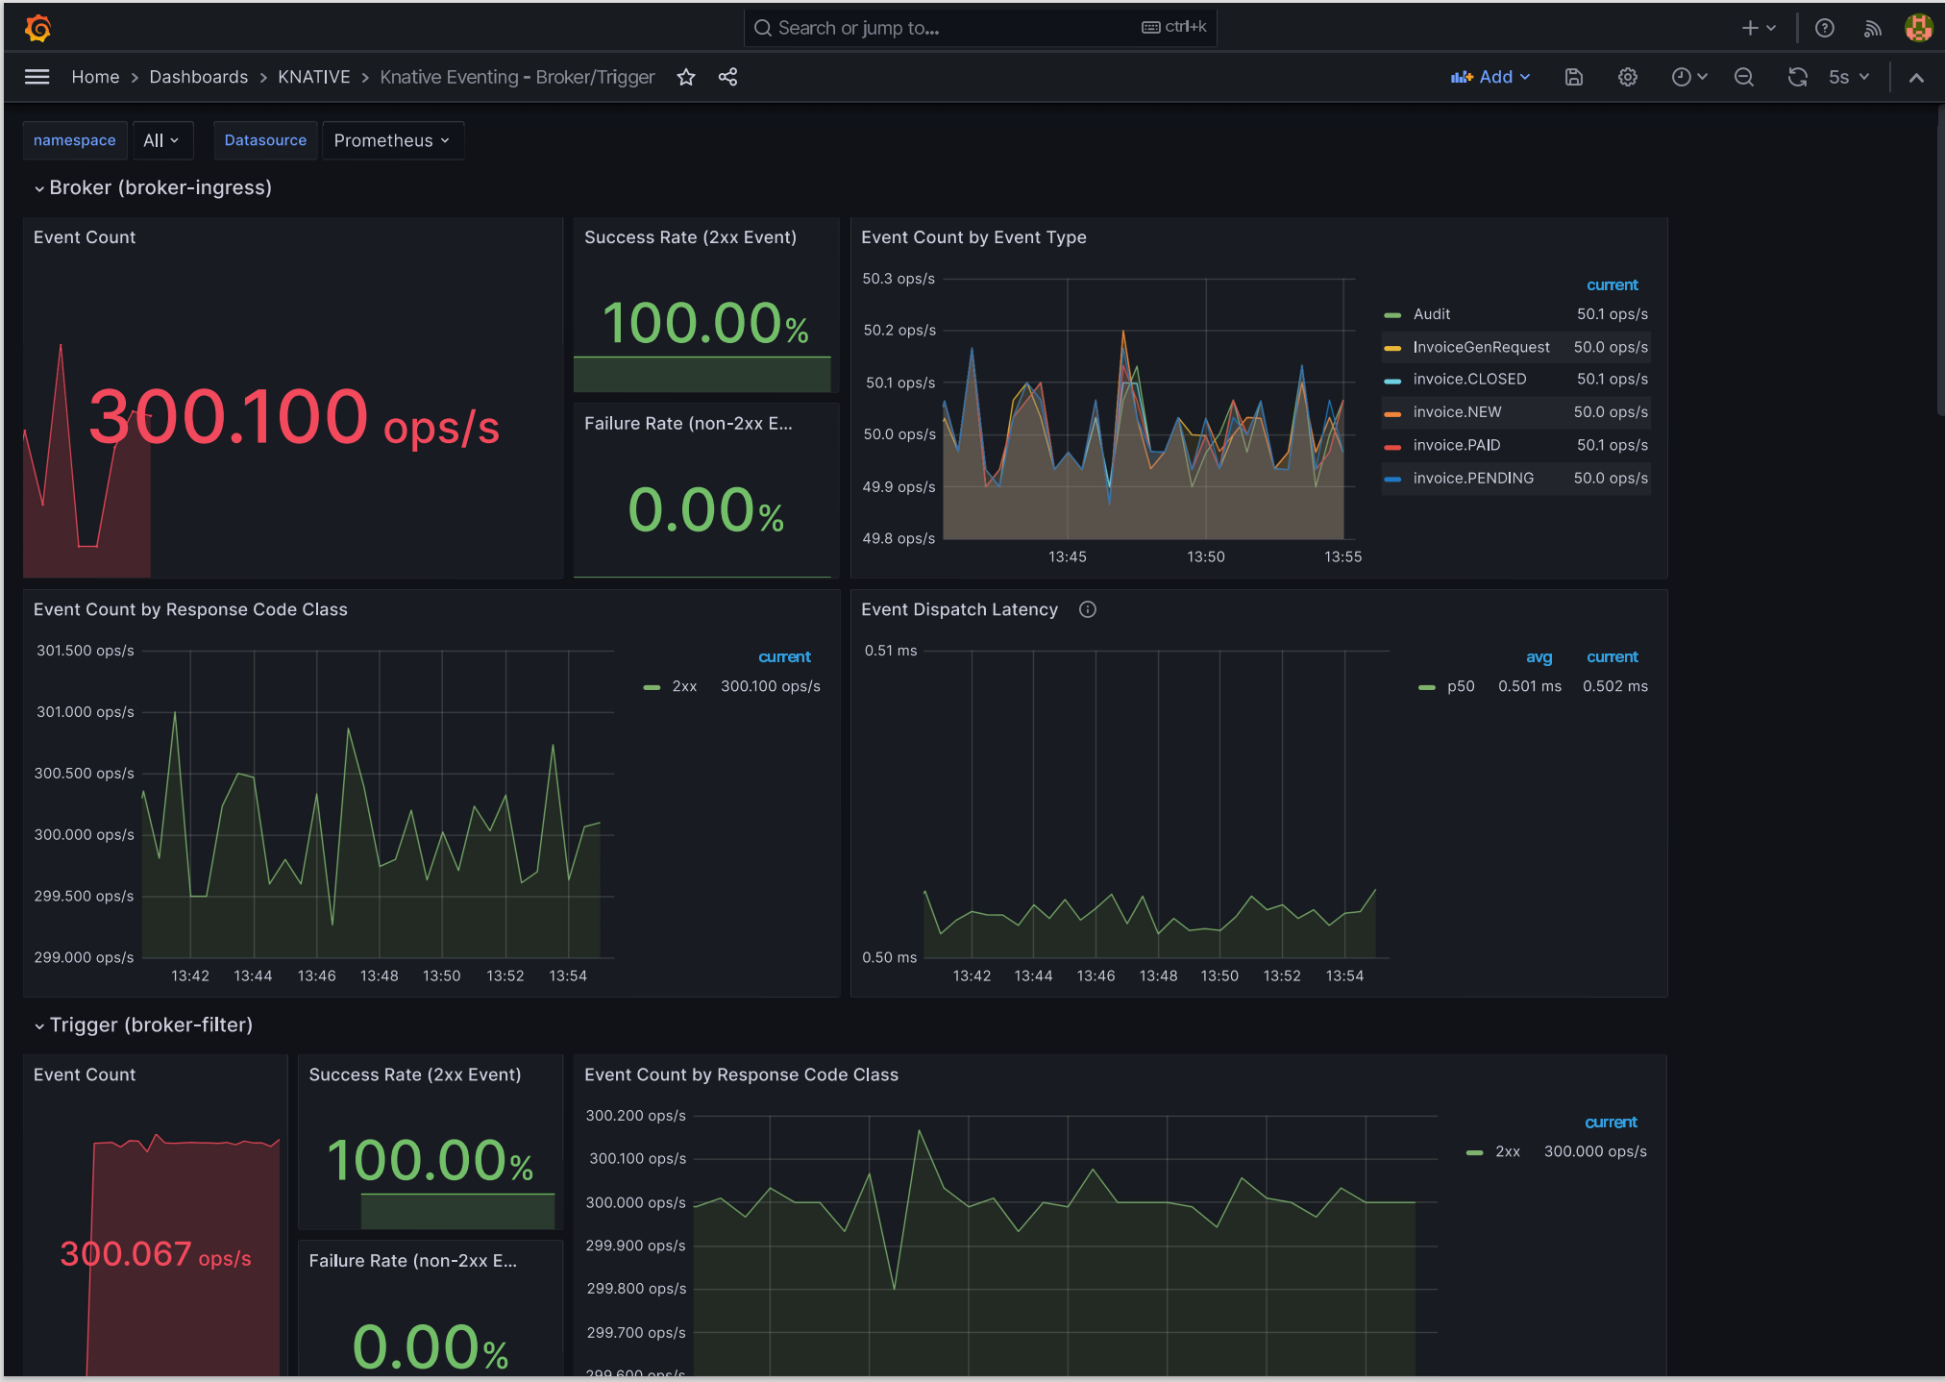
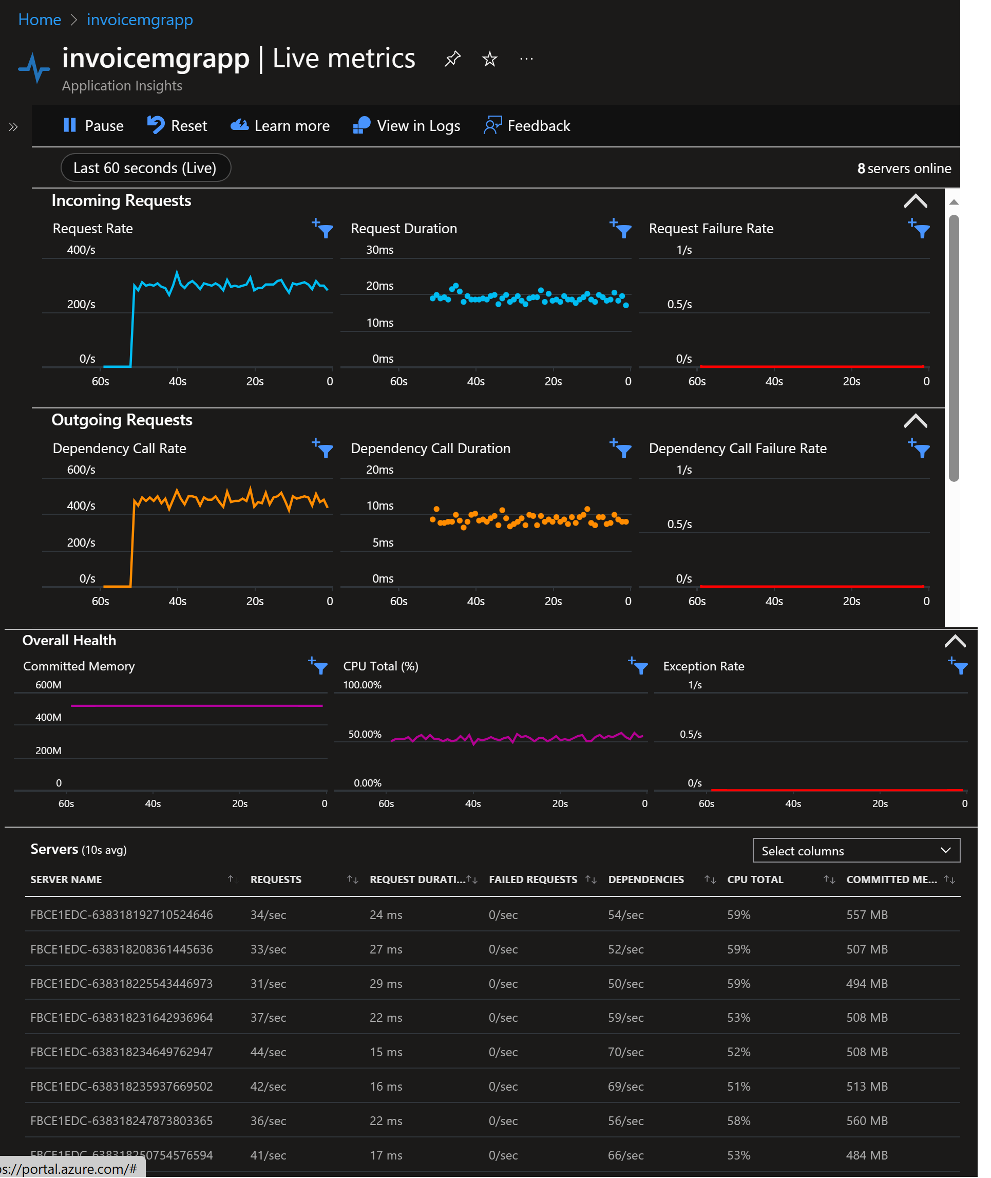

Slide 10
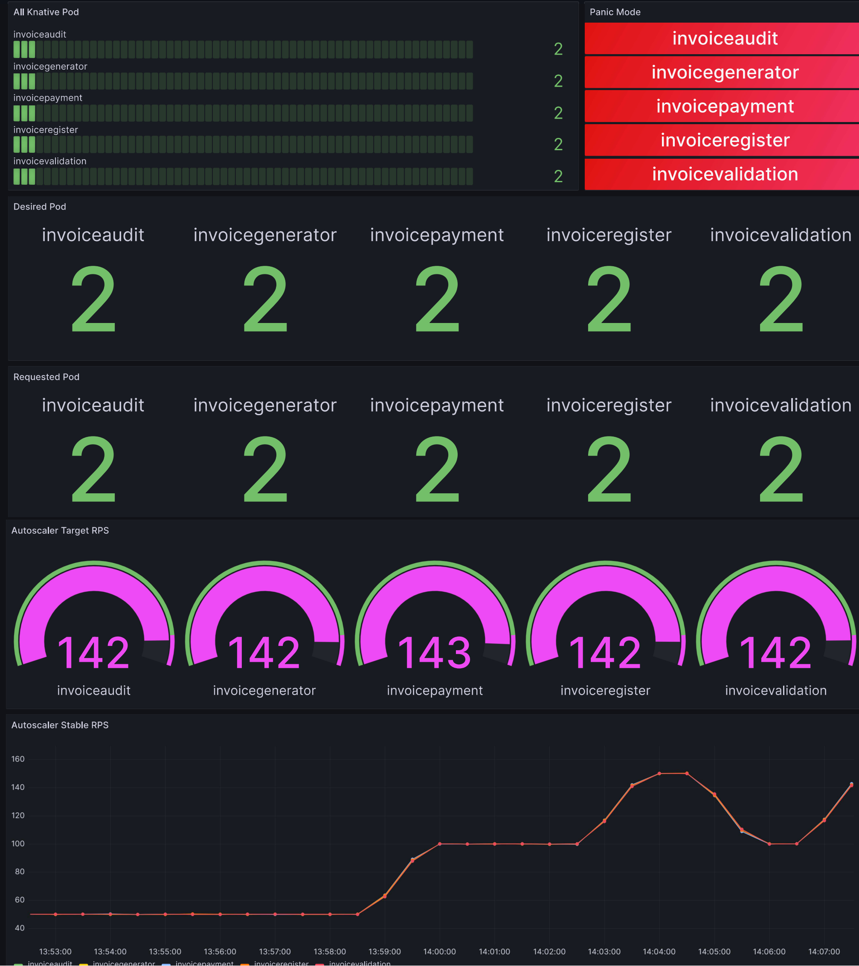
Knative: Metrics, Grafana View, ( Autoscaling )
The Autoscaling is set for Request Per Seconds, with threshold value of 200 RPS (or TPS).
But Functions will go in a PANIC state when RPS is 70% of threshold (140)
Functions PANIC state is visible Grafana view marked as RED
Autoscaler will now request 2 PODs per functions to handle the load.
Knative Serving uses Kubernetes API to Scales the PODs to 2

Slide 11
Knative: Back to Normal
The traffic is normalized below threshold, Autoscaler will request the Knative Serving to reduce the desired pod to default .
Desired functional instances is reduced to One
The requested POD is reduced to ONE
POD’s are NOT in Panic State anymore

Slide 12
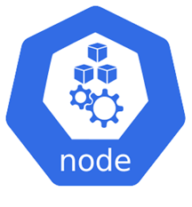





Cost Analysis
Core PODS
App. Function PODS
Addition Costing
Fixed Number of Nodes
Fixed Resources
Knative Services and POD will be always running. (~ 15 Pods)
Controlled Cost
Zero Traffic Volume
Application PODs Scaled to Zero
Resource Consumption will increase, but controlled under same number of Nodes
HIGH Traffic Volume
Autoscaler scales up the application PODS

Slide 13


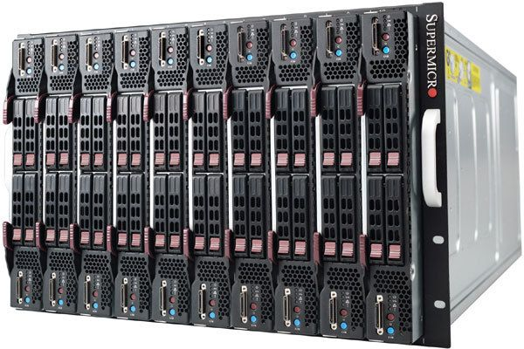
Cost Analysis
Azure Functions
Zero Traffic Volume
Functional instance Scaled to ZERO
Pay on what you use
Increases number of functional instances
Increase in Computing Resources
HIGH Traffic Volume
Reduced Server Management
Increase in Cost
Azure Functions provides “Cost Savings” if Traffic volume is low to moderate, and only fluctuates to higher value for limited Period of Time

Slide 14
Conclusion
Knative is Cloud-Native , Open-Source offering
releases companies from a “Vendor Lock-In” situation.
It is offered over Kubernetes cluster
Good choice for companies already have Kubernetes in their Technology Map
Need Team of Dedicated SRE and Support Team to monitor all Kubernetes and Knative resource
Azure Function App is good choice for Customers who want to avoid expensive maintenance cost of managing Kubernetes infrastructure and Service Mesh.
Customers can choose to be “vendor locked” in contrast to complex management of the PAAS infrastructure.
Azure functions offers different Hosting Plans, to reduce or avoid cold-start
Premium Plan only.

